Slide 1

Voltly ( A SMART ELECTRICITY BILLING SYSTEM )
A C++ Application Built on Core OOP Principles
GROUP MEMBERS: AYAN AHMED TAHA KASHIF

Slide 2

SYSTEM OVERVIEW
Streamlining utility management through automated consumption tracking, dynamic billing logic, and persistent data storage.

Slide 3






CORE PROJECT OBJECTIVES
Automation
Data Integrity
Flexibility
Replacing manual billing processes with a self-calculating algorithm that handles calculations easily
Enforcing strict encapsulation and secure file handling to prevent data loss or unauthorized access.
Managing diverse consumer types Residential, Commercial, and Solar within a unified C++ architecture.

Slide 4
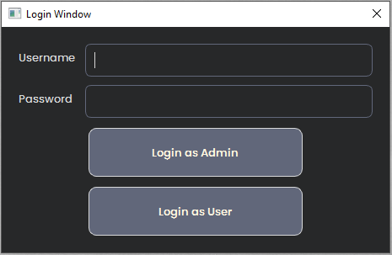
SYSTEM ARCHITECTURE DESIGN
The system utilizes a modular architecture where concerns are separated into specialized classes:
Consumer Core: Handles specific billing logic and unit tracking.
Persistence Layer: Manages file read/write operations via FileManager.
Authentication: Secure login flow for Admin and User roles.
Admin Core: Provides methods for admin operations

Slide 5

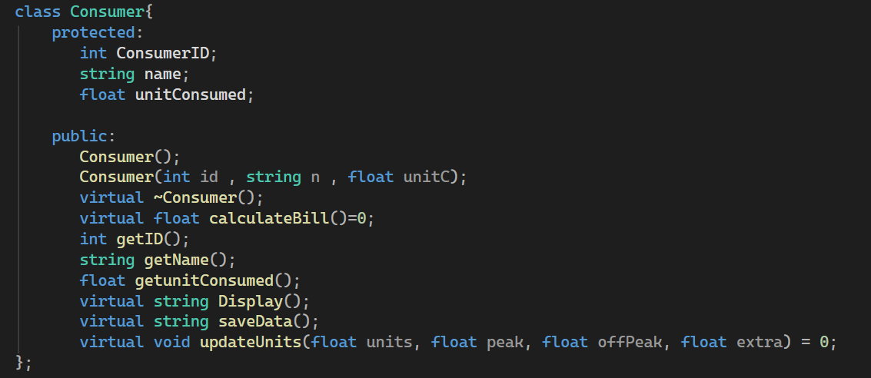
OOP: INHERITANCE HIERARCHY
Abstract Base Class : Consumer Class
The base class utilizes Abstraction and Pure Virtual Functions to enforce a blueprint for all sub-classes.

Slide 6
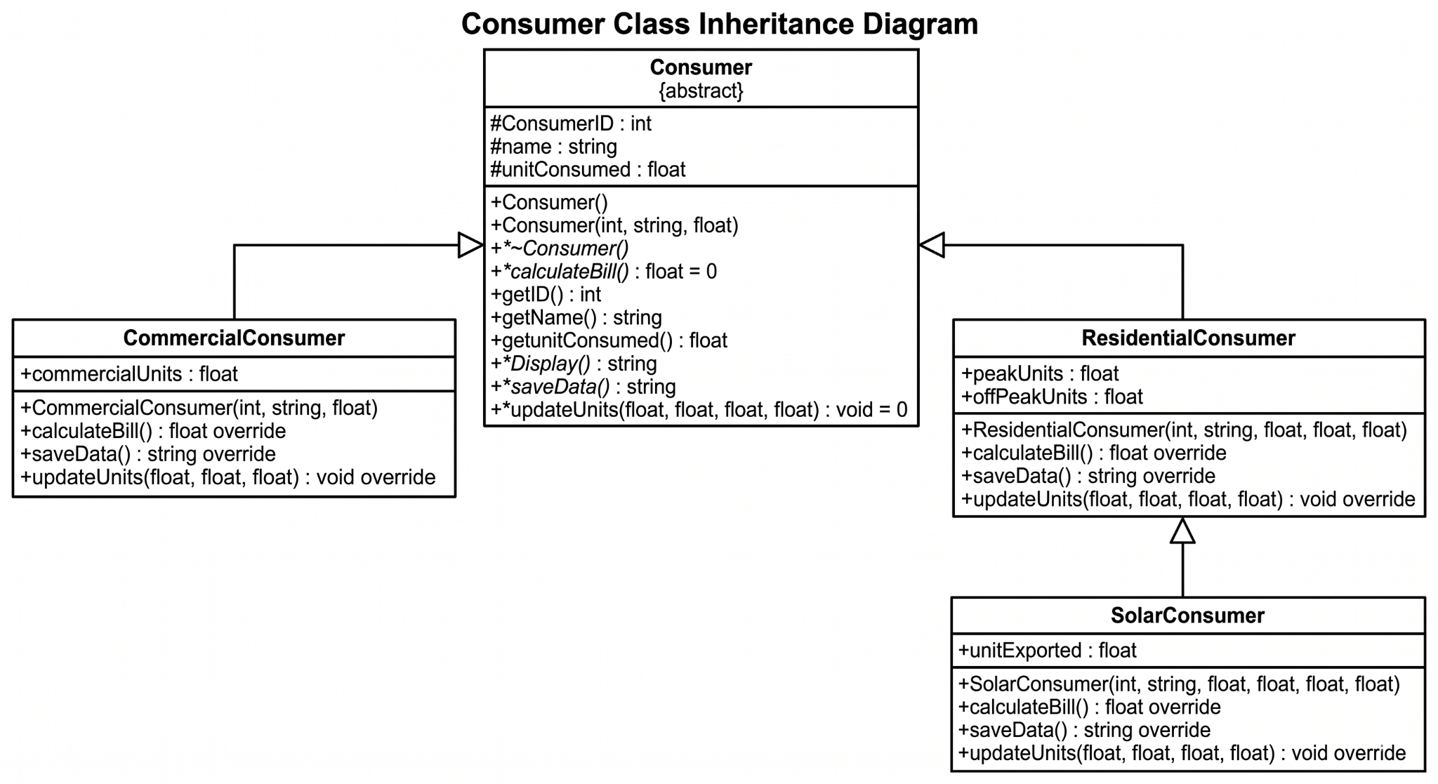

OOP: INHERITANCE HIERARCHY
Inheritance Structure
Residential: Base tier with Peak/Off-Peak logic.
Commercial: Flat rate with high-volume scaling.
Solar: Net-metering extension of Residential.

Slide 7
DYNAMIC BILLING LOGIC
Overview
This table outlines the logic and default pricing rules the system uses to calculate utility bills across different consumer categories. Key Takeaways:
Commercial Tier: Employs a straightforward flat-rate calculation based on total units consumed.
Residential Tier: Utilizes a dual-rate system, separating peak and off-peak consumption to calculate a weighted total, reflecting real-world variable grid pricing.
Solar Tier (Net-Metering): Builds upon the residential framework by factoring in an "exported units" variable. The system automatically calculates the value of the energy the consumer feeds back into the grid and deducts it from their total usage, seamlessly handling bill reductions or generating credits.
Consumer Type | Inputs Required | Formula | Default Rates Applied
Commercial | units | units * commercialRate | units * 25
Residential | peak, offPeak | (peak * residentialPeakRate) + (offPeak * residentialOffPeakRate) | (peak * 20) + (offPeak * 15)
Solar | peak, offPeak, exported | (peak * residentialPeakRate) + (offPeak * residentialOffPeakRate) - (exported * solarRate) | (peak * 20) + (offPeak * 15) - (exported * 10)

Slide 8
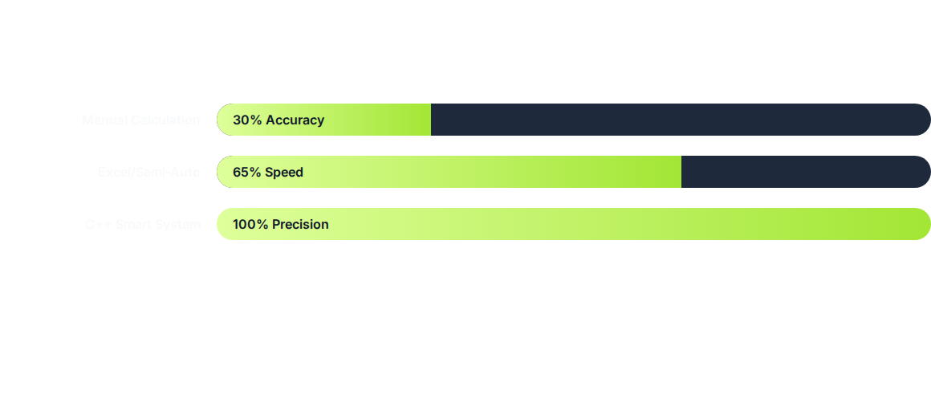
MANUAL VS. AUTOMATED EFFICIENCY
Automation reduces human error by 95% and cuts processing time from hours to milliseconds.

Slide 9
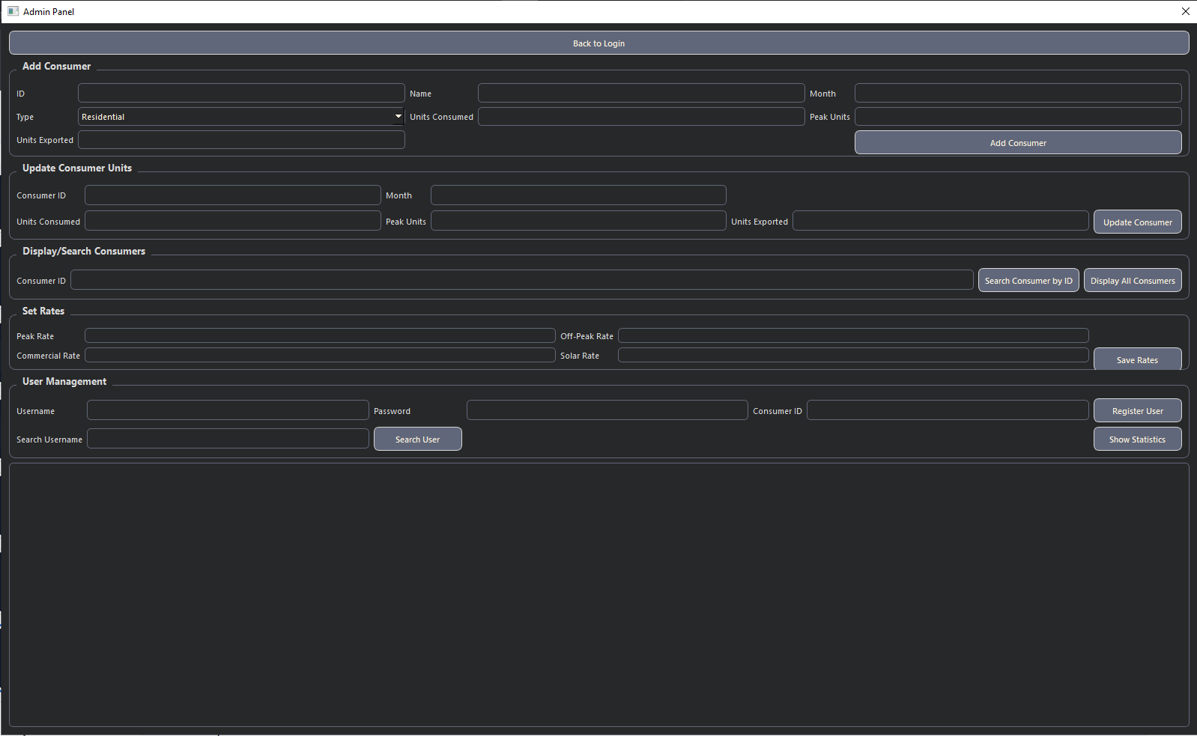
ADMIN CONTROLS
The Admin Dashboard provides high-level oversight and management tools:
Polymorphic Management: Store all consumer types in a single array using Consumer* pointers.
Global Statistics: Real-time tracking of total collected revenue and outstanding bills.

Slide 10
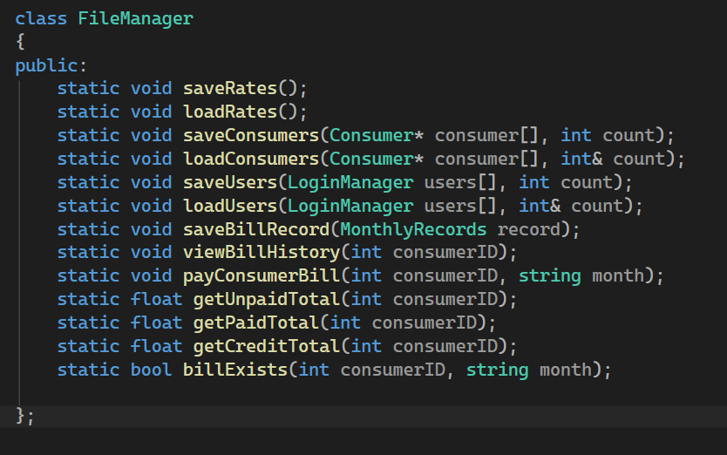
FILEMANAGER: DATA LAYER
Static Persistence Layer
The FileManager class is designed with static methods for a stateless utility approach.
Consumers.txt: Records consumer data.
Bills.txt: Historical billing records with payment flags.
Users.txt: Records User Data
Rates.txt: The Rates for Consumers are stored

Slide 11
Conclusion
Voltly is an excellent example of how programming fundamentals can be made useful in the practical domain of utility management. Using OOP concepts like polymorphism to calculate tariffs dynamically, as well as abstraction for a well-designed structure, the program turns a difficult manual operation into a streamlined, accurate, and scalable one using C++. Along with an efficient file handling module, it provides a solid base for present use and future enhancements, including database and GUI integrations.

Slide 12
THANK YOU
Smart Electricity Billing System (C++)
Questions & Discussion

